Slide 1
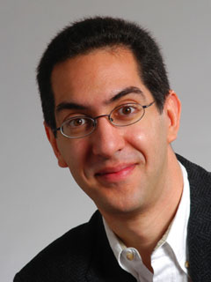
Rsa security conference 2013 in SF just over…
The Beauty and Joy of Computing Lecture #13 Social Implications of Computing III
UC Berkeley EECS Sr Lecturer SOE Dan Garcia
This meeting of privacy experts just finished, and the key questions that emerge: “Will people share their personal information freely in exchange for customized service? Or will they be fiercely protective, to protect identity?”
www.cnn.com/2013/02/28/tech/web/online-privacy-policies

Slide 2
Overview
Privacy
Examples of media stories and lessons learned
Intellectual Property
E-Voting

Slide 3
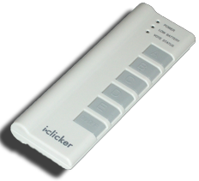
Peer Instruction
How much of your personal life do you reveal online?
Nothing. I have no online footprint. Google’d find nada.
You might find a photo or two of me, not much else.
You would find photos & blogs & videos of me if you were my friends or family, not much else.
You’d find photos & blogs & videos & tweets, but nothing embarrassing. I filter what I put up.
My entire life is visible to the world. I hold nothing back. Location, videos, etc. JennyCam has nothing on me.
Notes:
Answer: D (includes everything in which the computer poses a question and you have to answer in a computer-readable form, which so far means multiple choice)

Slide 4
Tyler Clementi, RIP
en.wikipedia.org/wiki/Suicide_of_Tyler_Clementi
Student at Rutgers who was cyber-bullied in Sep
Filmed by roommate in a sexual encounter (twice)
After he found out and complained, and found out it had happened again, he committed suicide
The same month, four other teens committed suicide after “bullying”
Internet amplification of invasion of privacy
His roommate was convicted of 15 counts of invasion of privacy, bias crimes and hindering prosecution
He served 20 days in prison + 300 hours of community service

Slide 5
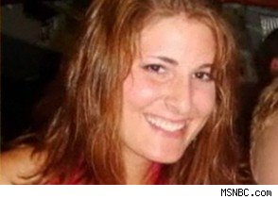
Karen Owen’s Powerpoint
www.msnbc.msn.com/id/21134540/vp/39552594#39552594
Student at Duke who documented sexual encounters in PPT
41 pages, photos and tables and graphs
Men are ranked, physical details shared
Shared with 3 others
Went Viral
Lesson
Anything can go viral, permanently

Slide 6
Ten Principles for Social Media Privacy
Dr. Gerald Friedland and I have a research group around this!
Your information footprint is larger than you think.
There is no anonymity on the Internet.
Any information about you on the Internet will be used by SOMEBODY in THEIR interest -- including against you.
Communication over a network, unless strongly encrypted, is never just between two parties.
Sharing information over a network means you give up control over that information.
Anything said on the Internet is open to interpretation, including what you say and what is said about you.
The Internet not only duplicates (exponentially) but it never forgets!
Just because it can't be found today, doesn't mean it can't be found tomorrow.
Identity is not guaranteed on the Internet.
Avoiding the Internet doesn’t help: Others may post about you.

Slide 7
Peer Instruction (thanks to BH)
www.riaa.com/physicalpiracy.php?content_selector=piracy_online_the_law
Music on your portable player: Where do you get it?
I paid to download everything on my iPod
I bought everything, either as a download or ripped from CD/DVD
I bought most of my music but there are few exceptions
I bought a little of my music, but most of it I didn’t buy
It’s all from Limewire / BitTorrent / friends / etc
Notes:
Answer: D (includes everything in which the computer poses a question and you have to answer in a computer-readable form, which so far means multiple choice)

Slide 8
Intellectual Property
en.wikipedia.org/wiki/Copyright_Term_Extension_Act
copyright.gov
BH:
“We’re going to make a bargain with creators. We’re going to give you a limited time monopoly to profit from your idea in return for sharing your idea with us. … Congress keeps extending the duration of copyright”
US Constitution, Article I, Section 8:
“The Congress shall have power… to promote the Progress of Science and useful Arts, by securing for limited Times to Authors and Inventions the exclusive Right to their respective Writings and Discoveries.”
Logo for opposition to CTEA

Slide 9
Creative Commons
creativecommons.org
A GREAT way to share / remix / reuse content
Legal!
Infrastructure that makes it possible
UC Online
This issue has come up; they have to find the right one…
BY = Attribution | Share Alike | No Derivs | Non Commercial
CC BY
CC BY SA | x
CC BY ND |  | x
CC BY NC |  |  | x
CC BY NC SA | x |  | x
CC BY NC ND |  | x | x

Slide 10
Peer Instruction
“I trust electronic voting machines & infrastructure.”
I strongly disagree
I disagree
Neutral
I agree
I strongly agree
Notes:
Answer: D (includes everything in which the computer poses a question and you have to answer in a computer-readable form, which so far means multiple choice)

Slide 11
E-Voting
seattletimes.nwsource.com/html/localnews/2014398575_apwaxgrlegislature.html video.google.com/videoplay?docid=7926958774822130737# en.wikipedia.org/wiki/Hacking_Democracy
“Hacking Democracy” is an Emmy-nominated documentary
Harri Hursti demonstrates “Hursti Hack” on Diebold machines thought safe
Some states allow online voting (e.g., for military)
It’s really scary, folks

Slide 12
Summary
Be cautious about your online exposure
Fight for your privacy
Use Creative Commons to share / remix / reuse content
Pay for your music
or use Pandora, which does it for you
Fight online voting
CS195 to learn more
(Credit: Geekologie)

