Slide 1

Above the Clouds:
A Berkeley View of Cloud Computing
Armando Fox, UC Berkeley
Reliable Adaptive Distributed Systems Lab
© 2009-2011
Image: John Curley http://www.flickr.com/photos/jay_que/1834540/

Slide 2

What is distributed computing?

Slide 3
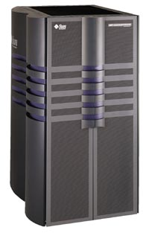
Your PC vs. Datacenter Computer, in 1996 & today
Sun E-10000 “supermini” c.1996
Machine | Processor cores | RAM | Disk
E10000, 1996 | 64 x 250MHz | 64 GB | 20 TB
PC, 1996 | 1 x 250 MHz | 32 MB | 4 GB
Ratio | 64:1 | 2000:1 | 5000:1
Datacenter computer, 2010 | 8 x 1 GHz | 16 GB | 2 TB
PC, 2010 | 2 x 3 GHz | 4 GB | 0.5 TB
Ratio | < 2:1 | 4:1 | 4:1

Slide 4
The first demonstration of how to build really large Internet sites out of clusters of commodity computers was done by:
(a) Stanford
(b) Berkeley
(c) Yahoo!
(d) Google
(e) IBM

Slide 5
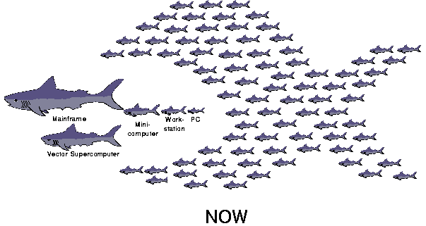
UC Berkeley Networks Of Workstations (1994-1999)

Slide 6
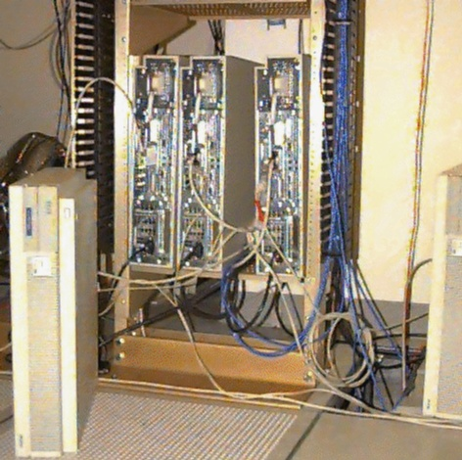
NOW-0 (4 HP-735’s)
NOW-0
1994
Four
HP-735’s

Slide 7
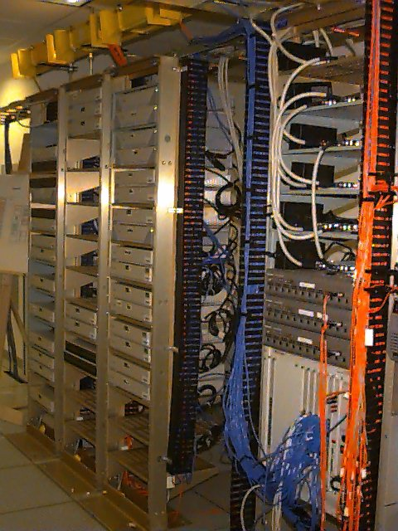
NOW-1
1995
32 Sun SPARC-
stations

Slide 8
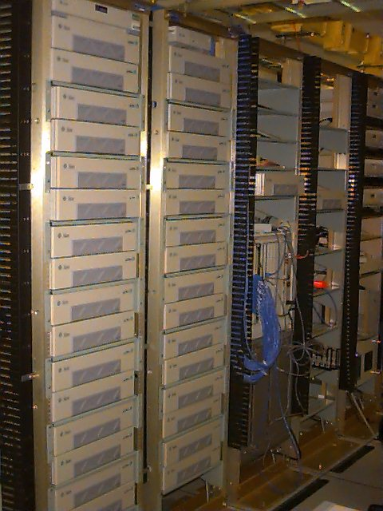
NOW-2
1997
60 Sun SPARC-2

Slide 9
Challenge: how do you program a NOW? How do you keep it running as individual machines fail?
Notes:
What's hard about programming NOW?
"Shared nothing" – to get stuff in someone else's memory/disk, have to do it explicitly
Handling partial failures
Management: As gets bigger, hard to manage so many machines
Heterogeneity: what if not all machines same?

Slide 10
Trivia Fact
The first full Web browser running on a mobile device was developed by:
(a) Apple
(b) Stanford
(c) Berkeley
(d) Nokia
(e) Motorola

Slide 11

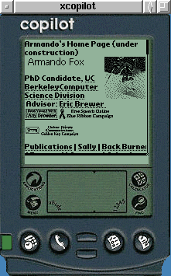
“Access Is the Killer App”
Project Daedalus, 1994-1999
Faculty: Profs. Katz & Brewer
Idea: Use the “cloud” for services!
  First truly scalable search engine (Inktomi)
  First mobile Web browser enabled by content transformation (TopGun)
  Vision: Anywhere, anytime access to data & services, supported by the “cloud”

Slide 12
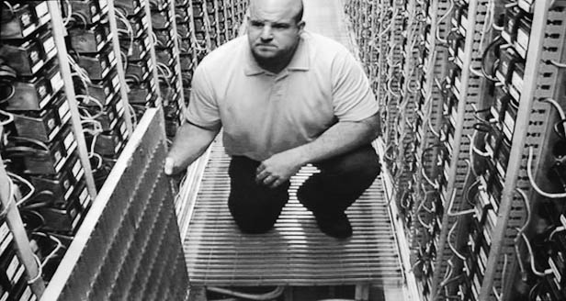
A Google datacenter built c.2005 would be designed to house approximately _______ computers.
(a) 1,000
(b) 5,000
(c) 10,000
(d) 50,000
(e) 100,000

Slide 13
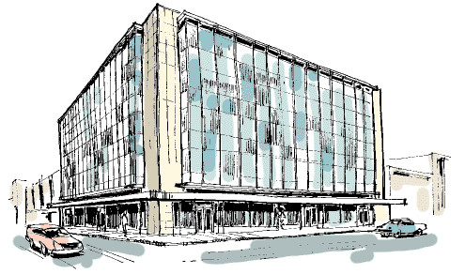
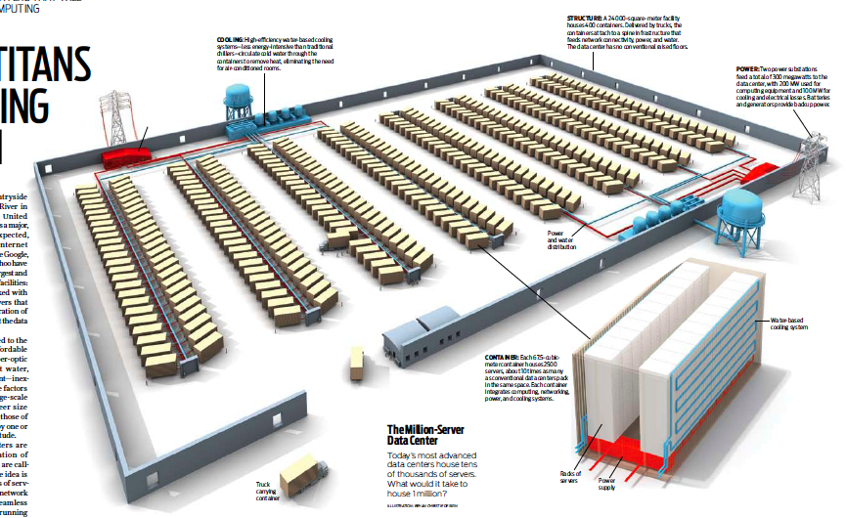
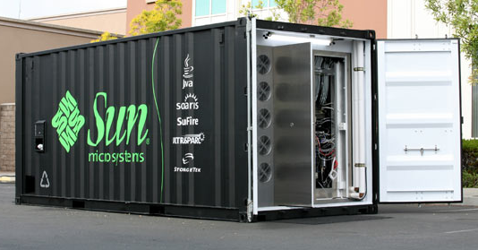
Datacenter is new “server”
“Program” => Web search, email, map/GIS, …
“Computer” => 1000’s computers, storage, network
Warehouse-sized facilities and workloads
13
photos: Sun Microsystems, CNET, & datacenterknowledge.com
Notes:
13
blackbox: 200KW racked HW, 7TB RAM, 1.5TB disk, 250 servers. roughly same comput capacity as all of Soda Hall.
Datacenters mainstream – but require capitalizing a company to program them

Slide 14















RAD Lab 5-year Mission
Enable 1 entrepreneur to prototype a great Web app over 3-day weekend, then deploy at scale
Key enabling technology: Statistical machine learning
Highly interdisciplinary faculty & students
  7 faculty across CS, from theory to systems
  2 postdocs, ~30 PhD students, ~12 undergrads

Slide 15
2007: Public Cloud Computing Arrives
Amazon Elastic Compute Cloud (EC2)
“Compute unit” rental: $0.02-0.68/hr.
  1 CU ≈ ~1 GHz x86 core
  Virtual machine technology used to “slice up”
No up-front cost, no contract, no minimum
Billing rounded to nearest hour
  pay-as-you-go storage also available
“Computing as utility”—MULTICS, c.1969
See abovetheclouds.cs.berkeley.edu
15

Slide 16
Why Now (not then)?
The Web “Space Race”: Build-out of extremely large datacenters (10,000’s of commodity PCs)
Driven by growth in demand (more users)
  Discovered economy of scale: 5-7x cheaper than provisioning a medium-sized (100’s machines) facility
  Infrastructure software: e.g., Google File System
  Operational expertise
More pervasive broadband Internet
Dominance of Intel x86 architecture in servers
Free & open source software availability
What’s new: risk transfer & cost associativity

Slide 17
Cloud Economics 101
Provisioning for peaks: wasteful, but necessary
Capacity
Machines
$
Demand
Capacity
Demand
Time
Time
“Statically provisioned”
data center
“Virtual” data center
in the cloud
Unused resources

Slide 18




Risk Transfer
(or: who remembers Friendster?)
Resources
Capacity
Demand
Resources
Capacity
1
2
3
Time (days)
Demand
Lost revenue
1
2
3
Time (days)
Resources
Capacity
Demand
1
2
3
Time (days)
Lost users

Slide 19
Cost Associativity
1,000 CPUs for 1 hour same price as
1 CPU for 1,000 hours
Washington Post converted Hillary Clinton’s travel documents to post on WWW
  Conversion time: <1 day after released
  Cost: less than $200
RAD Lab graduate students demonstrate improved MapReduce scheduling—on 1,000 servers

Slide 20
Challenge: Cloud Programming
Challenge: exposing parallelism
  Programmers must (re)write problems to expose this parallelism, if it’s there to be found
Challenge: operations
  Failures a constant fact when use 10,000 machines
  Automating the process of grabbing/releasing machines
Notes:
I said M/R was elegant, not necessarily intuitive
Open-source tools could still integrate much better than they do
Bottom line, though, is you have to find & expose //ism; also makes multicore prog hard.

Slide 21
Rising to the challenge
Programming
  BOOM (Berkeley Orders of Magnitude) simplifies creating cloud-scale storage services (Hellerstein et al.)
  SEJITS (Selective Embedded Just-in-Time Specialization) lets same Python programs exploit cloud-scale or CPU-level parallelism (Fox et al.)
Operations
  RAD Lab expertise in using machine learning to auto-scale servers and storage in cloud

Slide 22
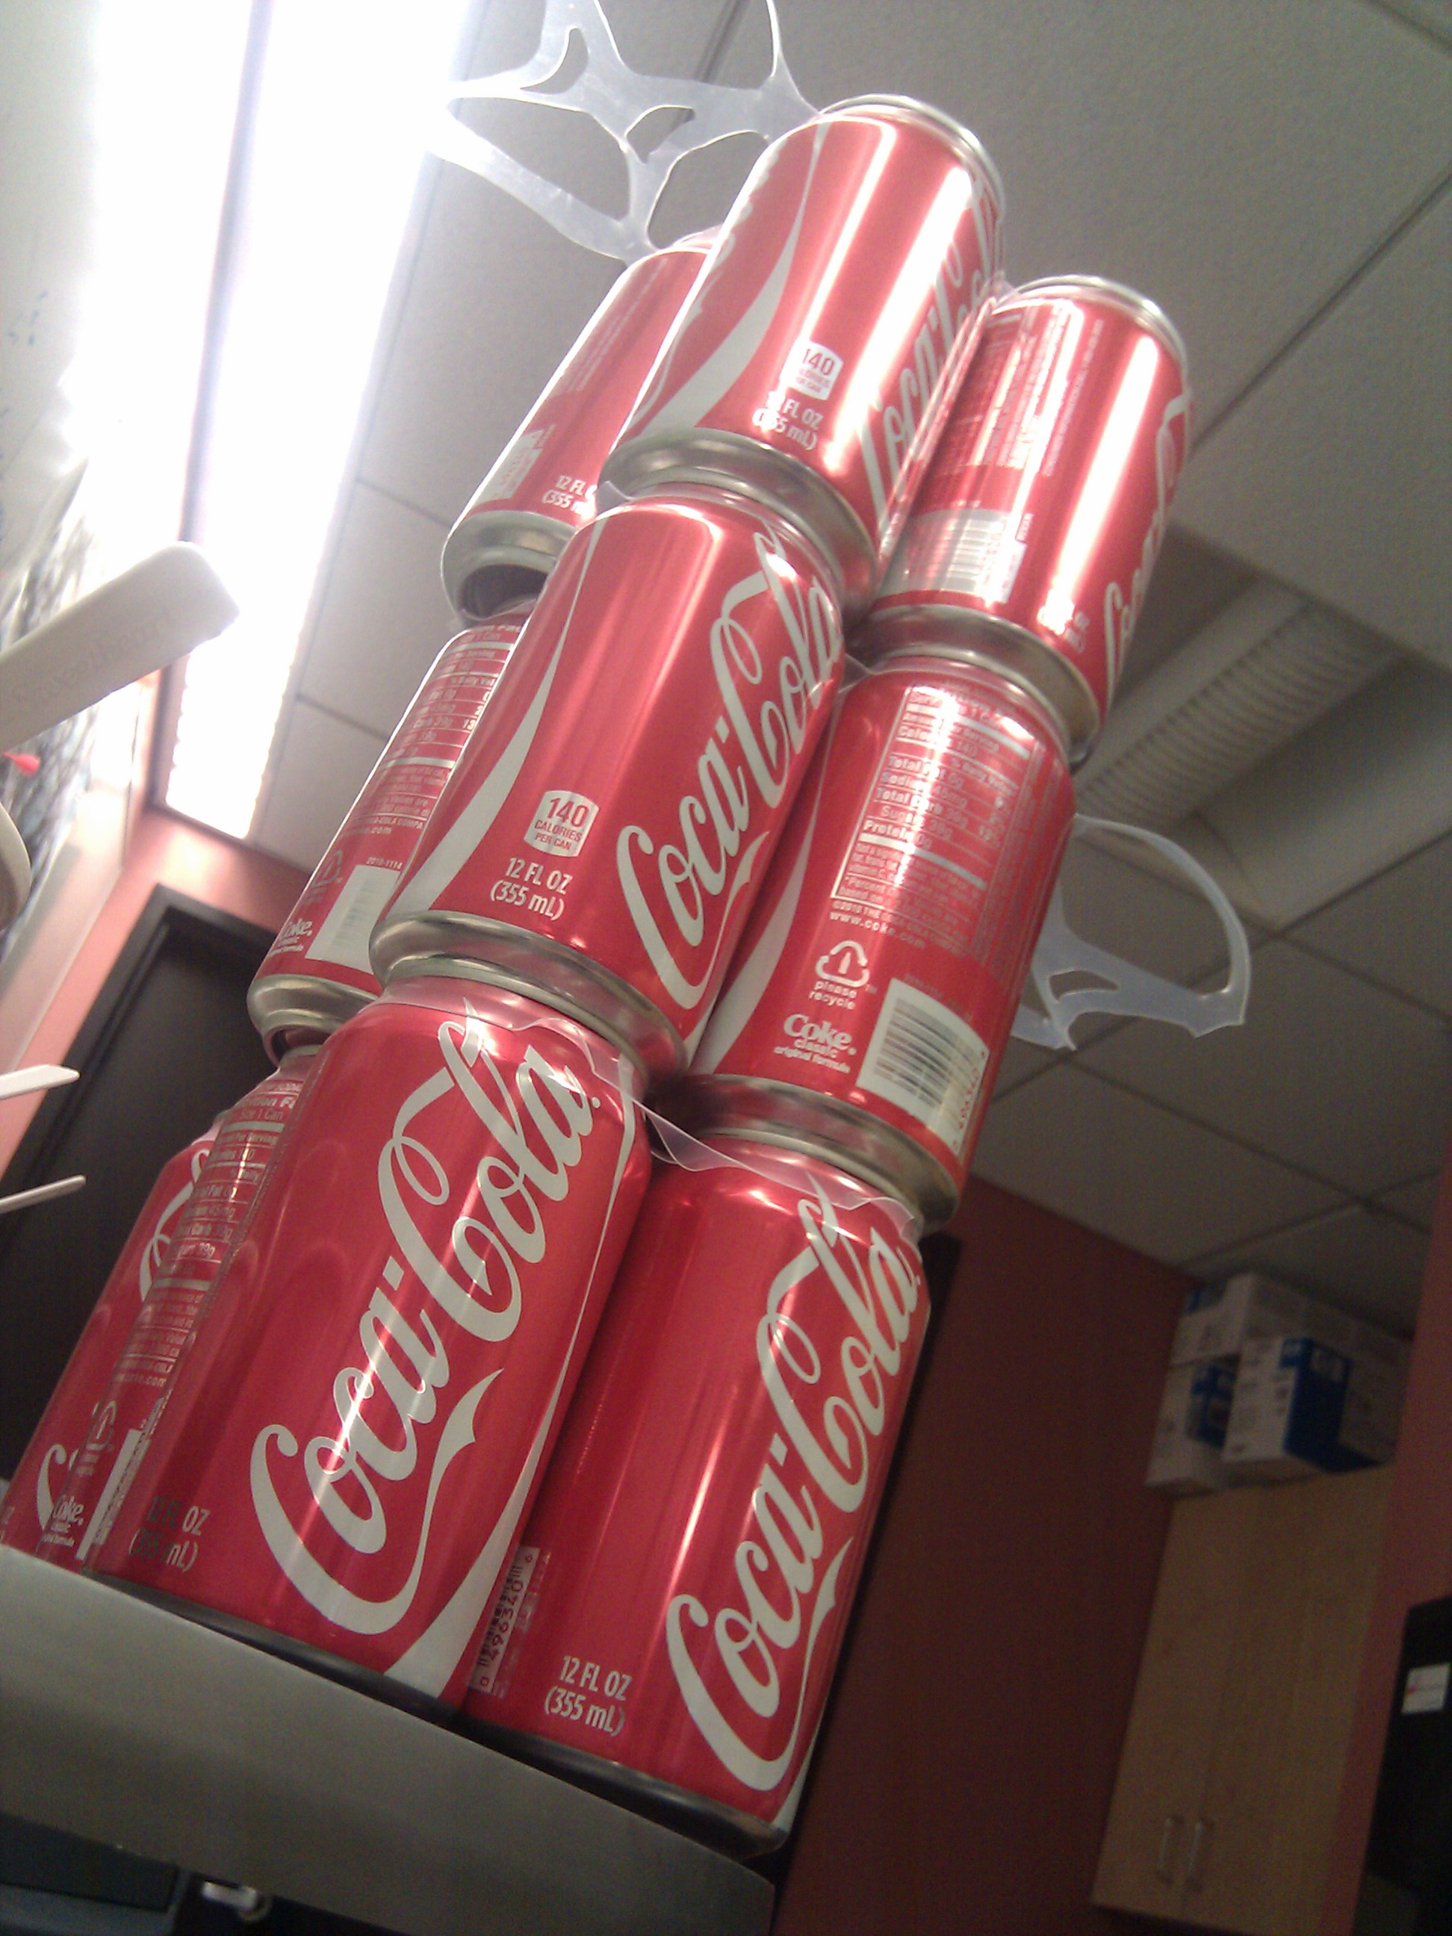

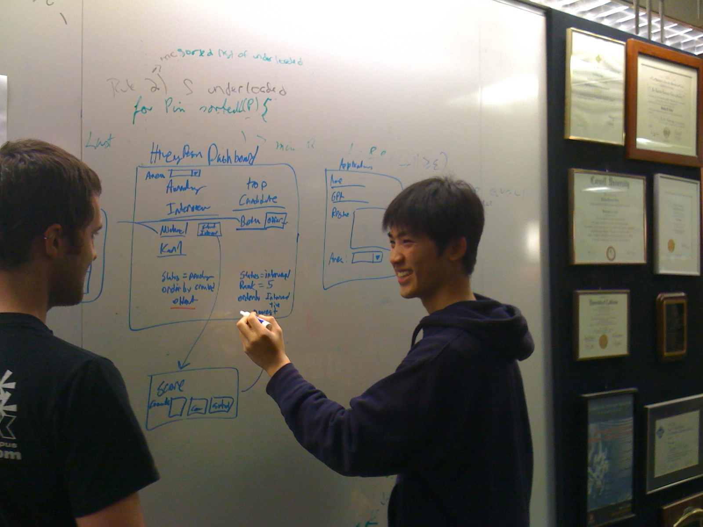
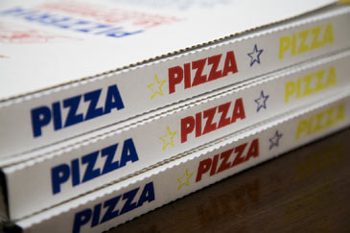
Success Stories:
Karl’s Long Weekend
Presidents’ Day Weekend, Feb 21-13
Final demo on Feb 24
Notes:
Many other students "pullled together" to make demo work

Slide 23
Cloud in Education
Berkeley research culture: integrate leading research into teaching at all levels
CS61C Great Ideas in Computer Architecture (reinvented Fall 2010): 190 students
CS169 Software Engineering for SaaS (in its 4th iteration): 50+50+50+70 students
CS162 Operating Systems: 70 students
(New course) Intro. Data Science (Spring 2010): 30
(New course) Programming Cloud Storage with BOOM (Fall 2011)
CS260 Adv. topics in HCI: 20 students
CS288 Natural language processing: 20 students

Slide 24
Cloud computing in courses
New undergraduate teaching opportunities
  SaaS: make a database fall over—would need 200 servers for ~20 project teams
  deploy projects publicly, many continue after course
Better use of resources
  Heavy usage right before lab deadlines
Better hardware
  Better machines than students’ own laptops
  Better machines than most UCB labs

Slide 25
Going back to NOW...
2000: using medium-
sized clusters for
Internet services
=> several PhD’s
2010: CS169 students do it in 6-8 weeks and deploy on cloud computing
  Everything delivered as SaaS now...
2020: ?

Slide 26
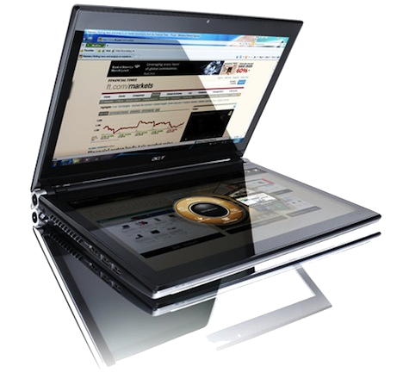
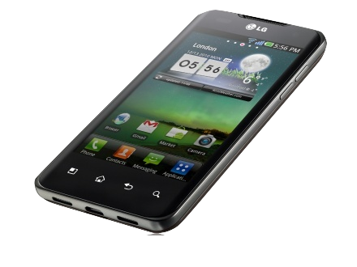
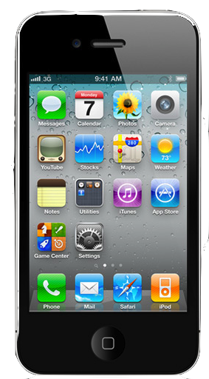
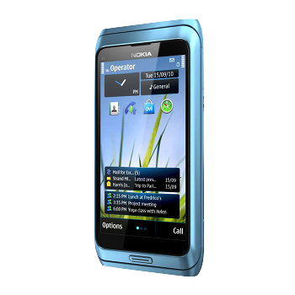
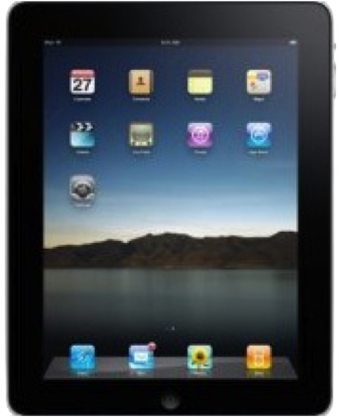

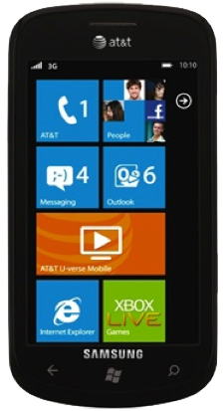
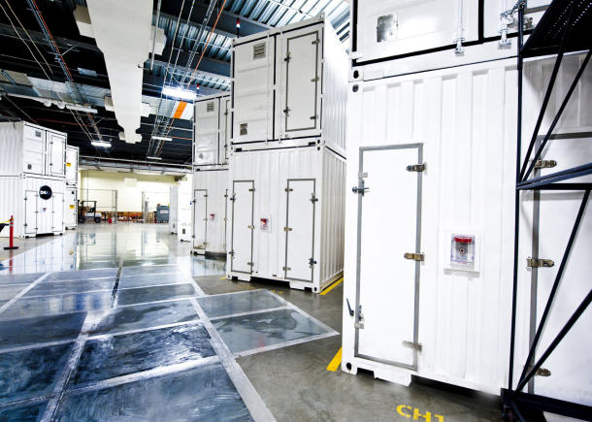
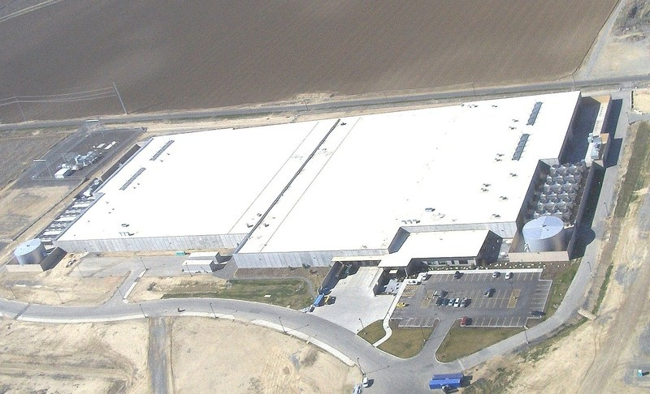
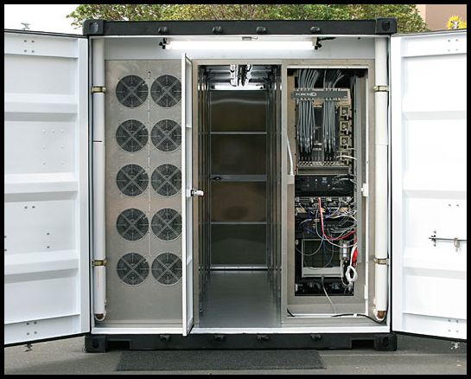
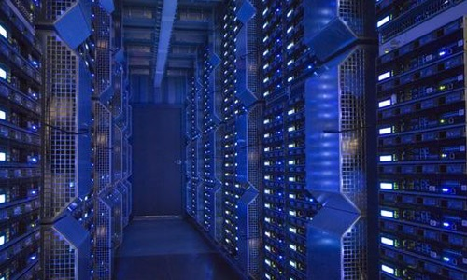
2011: Future=Mobile+Cloud
26
26
Notes:
26
Learn SaaS, don't worry about client programming but learn good UI design. Most advanced apps will include high-performance parallel code that's heavily shared, eg when you do Google Search you're using one of the world's most powerful supercomputers for microseconds.

Slide 27
Summary
Cloud computing democratizes access to large-scale computing resources
  Pay-as-you-go => low risk, low entry cost
Accelerates “SaaS-ification”
  Economic benefits of delivering software as a a service now available to anyone
Allows students, academia to have even greater impact on industry
Open up research/innovation opportunities

Slide 28
Relevant Topics?
SaaS architecture & cloud (CS 169)
Big data (CS 194 Intro to Data Science this semester)
Machine learning (CS 188)
Human-computer interaction (CS 160)
Non-goal: “iPhone programming”, “Android programming”, etc. (why?)

Slide 29
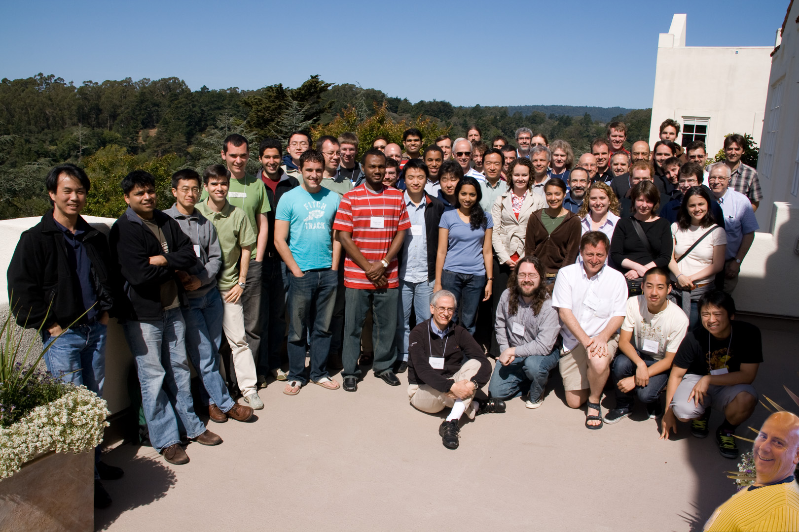
Thank you!
RAD Lab Team

