Slide 1
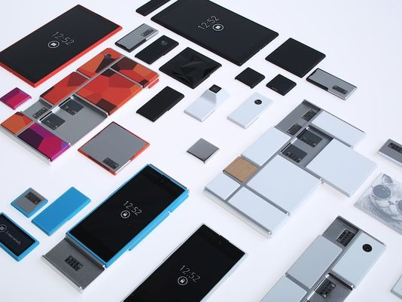
The Beauty and Joy of Computing Lecture #16
Internet II
UC Berkeley EECS Lecturer Gerald Friedland
Motorola aims at Smartphones
with interchangeable parts
Good: See IBM PC 1980s
Bad: See IBM PC 1980s
http://www.usatoday.com/story/tech/personal/2013/10/29/motorola-project-ara/3296887/

Slide 2
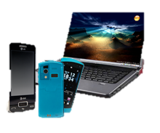
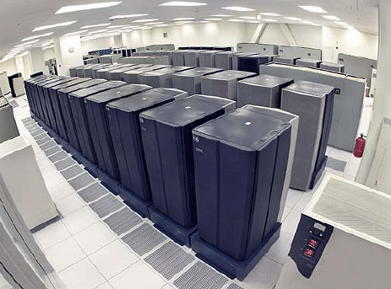
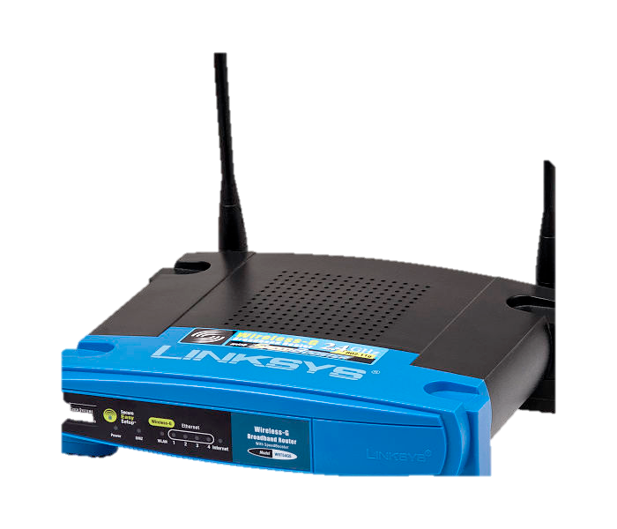
Components of the Internet: Physical
Server
Client
Router

Slide 3
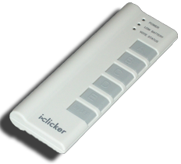
Question
Which of the following is wrong:
a) A server sends and receives data upon request from a client
b) Servers must be huge computers
c) A client can be a server at the same time
d) Routing is more than forwarding bits and can take significant computational resources
e) Public servers need a public IP unless behind a router that is reachable by a public IP and forwards

Slide 4
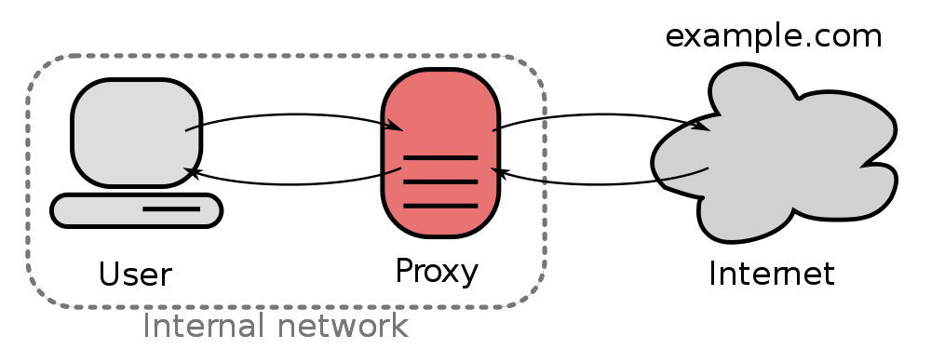
Virtual Components: Proxy
Proxy

Slide 5
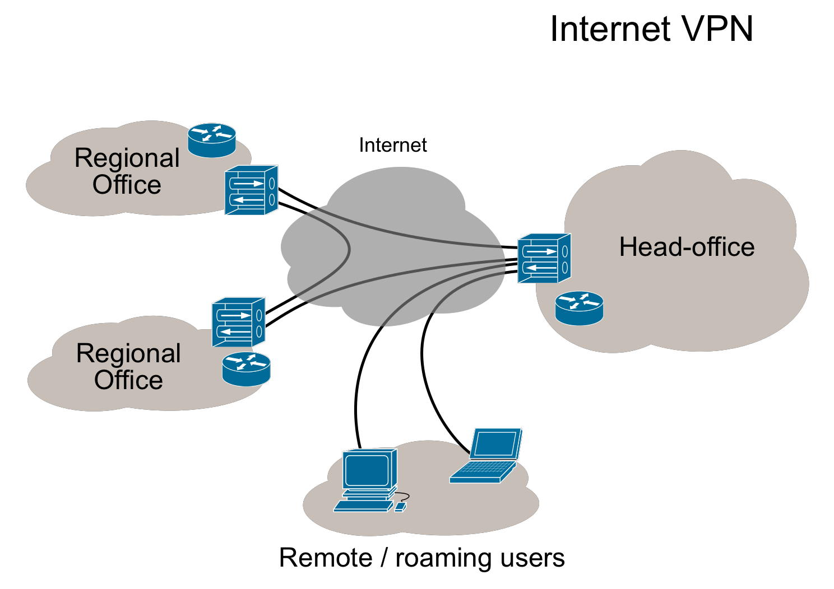
Virtual Components: VPN
Virtual Private Networks

Slide 6
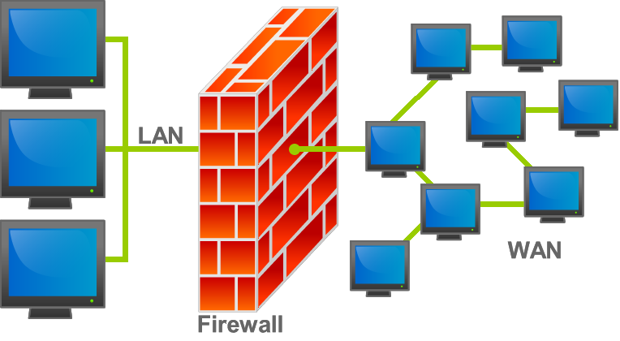
Virtual Components: Firewall
Firewall

Slide 7
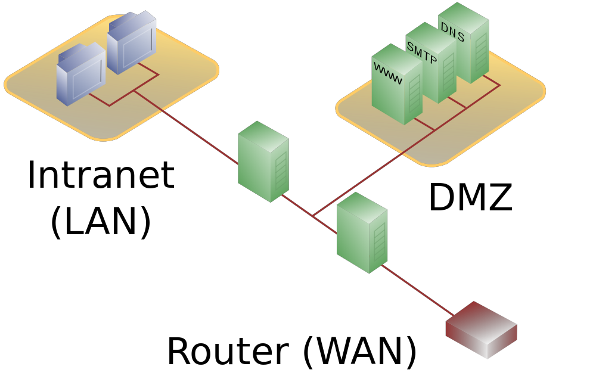
Virtual Components: DMZ
Demilitarized Zone

Slide 8
Question
Which of the following is wrong:
a) VPNs provide reasonable safety against people eavesdropping packets, even on WiFi
b) Proxies anonymize web requests
c) Firewalls are often part of routers
d) A DMZ always needs at least two firewalls
e) I don’t usually need a DMZ if I don’t serve content in some way

Slide 9
Protocols
Protocol = Language of the Internet
Examples:
Hypertext Transfer Protocol (HTTP)
File Transfer Protocol (FTP)
Simple Mail Transfer Protocol (SMTP)
Transfer Control Protocol (TCP)

Slide 10
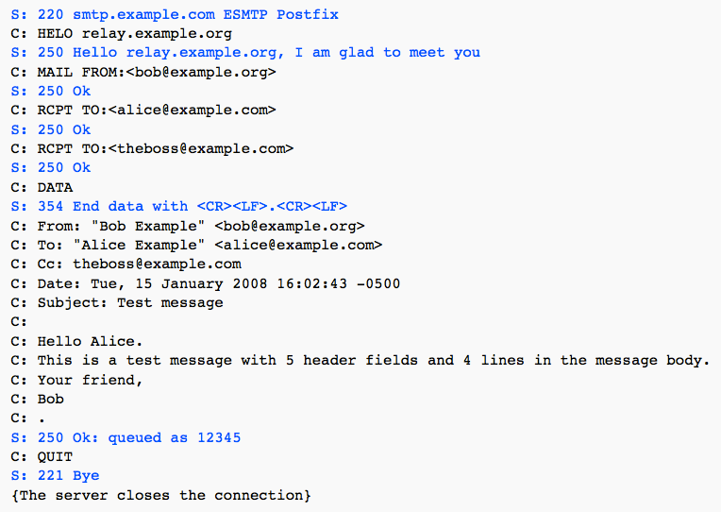
Protocols

Slide 11
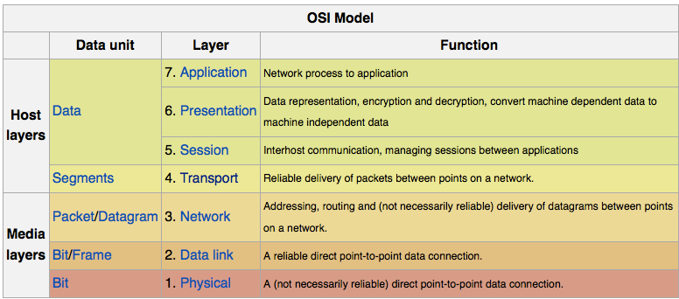
Protocol stack: Open Systems Interconnection

Slide 12
Encryption
Encryption is the essential security component of the Internet. Common protocols:
PGP for e-mail
https:// for http://
SSH for remote shells (instead of telnet)
SCP and SFTP for file transfer (replaces rcp and ftp)
DES for passwords
Adds itself into OSI layer.

Slide 13
Question
Have you ever used encryption for your e-mails?
No
Yes, using PGP
Yes, using other than PGP

Slide 14
Encryption: How it works
Two types of encryption:
Symmetric (Shared Key)
Issue: Key needs to be send
over Internet… (not a solution)
Asymmetric
Used by secure protocols today

Slide 15
Encryption: How to not send keys
http://www.youtube.com/watch?v=3QnD2c4Xovk

Slide 16
Question
Does encryption help with privacy issues?

Slide 17
Speed Metrics
Latency = Time to establish connection
Also called ping time
Usually in ms range
Additive with route length
Hardware dependent
Throughput = Information per second transferred
Measured in bits/sec
Slowest connection in route dictates throughput
Hardware dependent

Slide 18
Threats to the Internet
Internet is vulnerable at bottlenecks
Computers are vulnerable and attackable
Malware (Virus, Worms, etc)
Denial of Service (DOS) Attacks
Internet is vulnerable to monopolization (e.g. switch from E-mail to Facebook)

Slide 19
Threats to Society
Dependence on the Internet by
Individuals
Economy
Governments
creates possibility for Cyberwar (see discussion)
Uncontrollable availability of information creates threats to some individuals, societies, governments
Data-driven economy changes privacy configuration of society

Slide 20
Internet Economy impacts Privacy
http://www.tacma.net

Slide 21
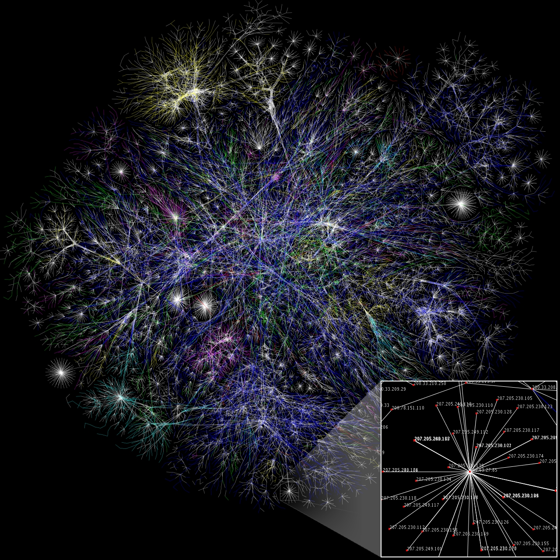
Summary
The Internet has physical and virtual building pieces and uses protocols
Encryption schemes allow safer point-to-point communication
The Internet is vulnerable as is society
http://commons.wikimedia.org/wiki/File:Internet_map_1024.jpg

