Slide 1
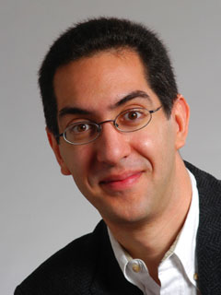
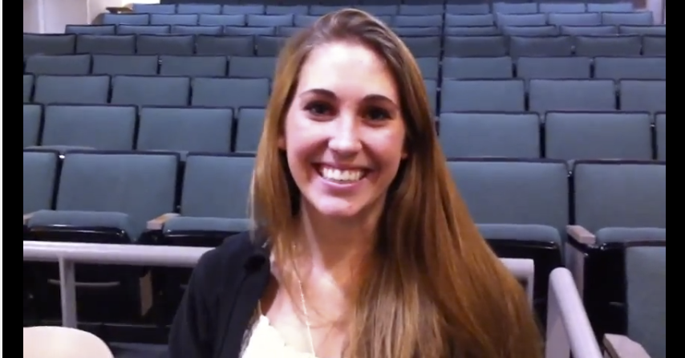
BJC: you’ll love it!
The Beauty and Joy of Computing Lecture #1 Welcome; Abstraction
UC Berkeley EECS Sr Lecturer SOE Dan Garcia
UC Berkeley EECS Lecturer Gerald Friedland
Watch the student testimonials about the course, what it means to them, and how it has changed their lives. Inspiring!
inst.eecs.berkeley.edu/~cs10/

Slide 2
BJC in one slide
Big Ideas of Programming
Abstraction
Algorithms (2)
Recursion (2)
Functions-as-data, λ (2)
Programming Paradigms
Concurrency
Distributed Computing
Beauty and Joy
“CS Unplugged” activities
All lab work in pairs
Two 3-week projects in pairs
Of their own choice!! (data + prog)
One writeup
Of students’ own choice!!
Big Ideas of Computing
HowStuffWorks
3D Graphics + Video Games
Internet
Research Summaries
AI
HCI
The Power of Data (big, small, etc)
Apps that Changed the World
Social Implications of Computing
Saving the World with Computing
Cloud Computing
Limits of Computing
Future of Computing

Slide 3
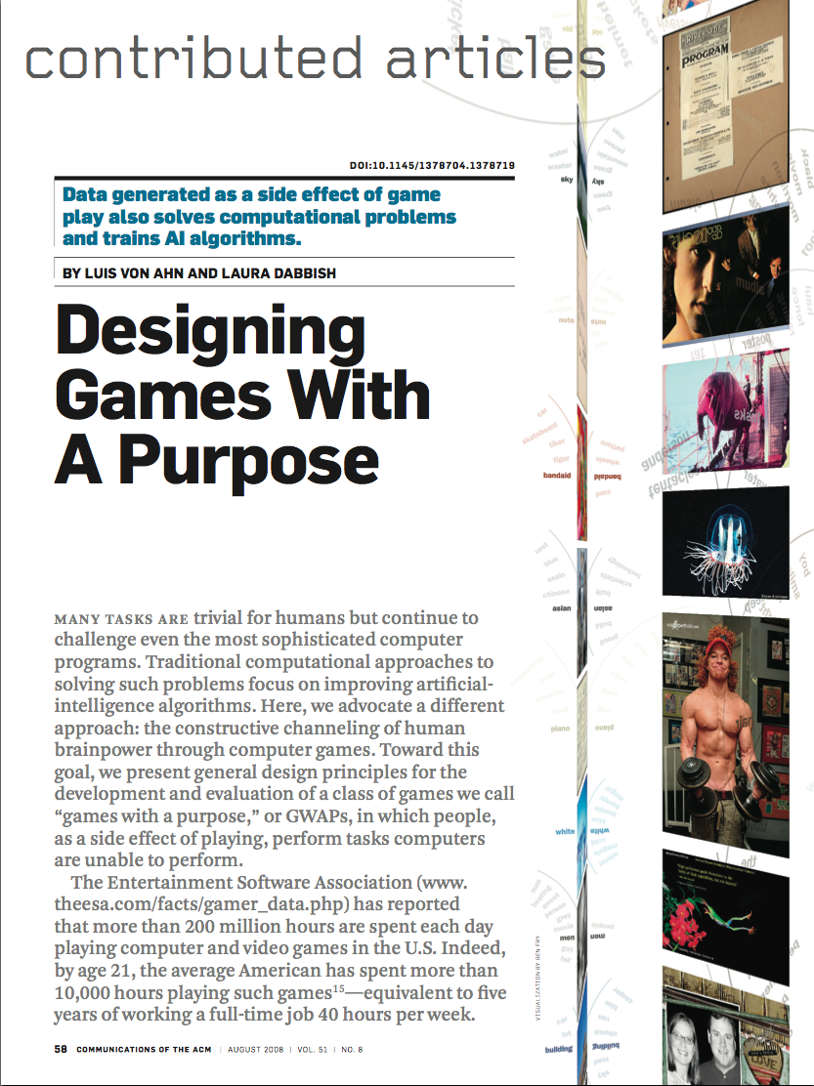
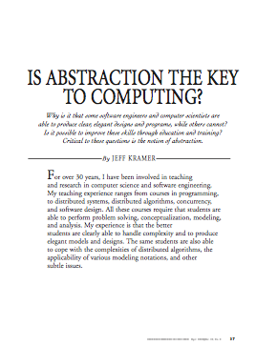
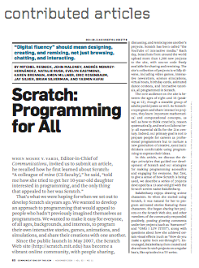
Format & Textbooks
Format (7 hrs/wk * 14 wks)
Selected Reading
Taken from great book (“Blown to Bits” by Abelson, Ledeen & Lewis) + articles + videos
Current events EVERY LECTURE (e.g., IBM’s Watson vs Jeopardy)
All resources FREE
Even clickers!
Pair Programming!
Mon | Tue | Wed | Thu | Fri
Lecture | Lab | Lecture | Lab | Discussion
 | Lab |  | Lab
…

Slide 4
Week at a glance

Slide 5
Let’s check enrollments (in real time)
We have NEVER turned anyone away … if more students sign up, we’ll open up more sections!
We don’t intend to turn anyone away now

Slide 6
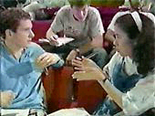
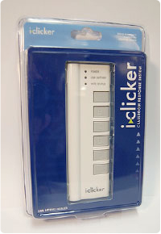
Peer Instruction
Increase real-time learning in lecture, test understanding of concepts vs. details
As complete a “segment” ask multiple choice question
1-2 minutes to decide yourself
2 minutes in pairs/triples to reach consensus. Teach others!
2 minute discussion of answers, questions, clarifications

Slide 7
Piazza for {ask,answer}ing questions

Slide 8
Pro-student Grading Policies
EPA
Rewards good behavior
Effort
E.g., Office hours, doing every single lab, hw, reading Piazza pages
Participation
E.g., Raising hand in lec or discussion, asking questions on Piazza
Altruism
E.g., helping other students in lab, answering questions on Piazza
You have 3 “Slip Days”
You use them to extend due date, 1 slip day for 1 day extension
You can use them one at a time or all at once or in any combination
They follow you around when you pair up (you are counted individually)
E.g., A has 2, B has 0. Project is late by 1 day. A uses 1, B is 1 day late
Late is 1/3 off/day

Slide 9
Abstraction
Detail removal
“The act or process of leaving out of consideration one or more properties of a complex object so as to attend to others.”
Generalization
“The process of formulating general concepts by abstracting common properties of instances”
Henri Matisse “Naked Blue IV”

Slide 10
Detail Removal
Automatic Generation of Detail Maps Maneesh Agrawala (UCB EECS), among others

Slide 11
Detail Removal (in BJC)
You’ll want to write a project to simulate a real-world situation, or play a game, or …
Abstraction is the idea that you focus on the essence, the cleanest way to map the messy real world to one you can build
Experts are often brought in to know what to remove and what to keep!
The London Underground 1928 Map & the 1933 map by Harry Beck.

Slide 12
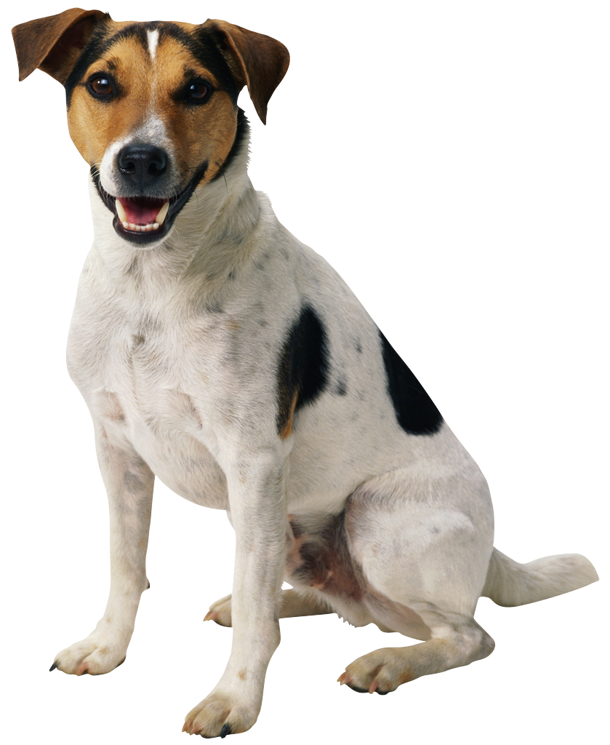
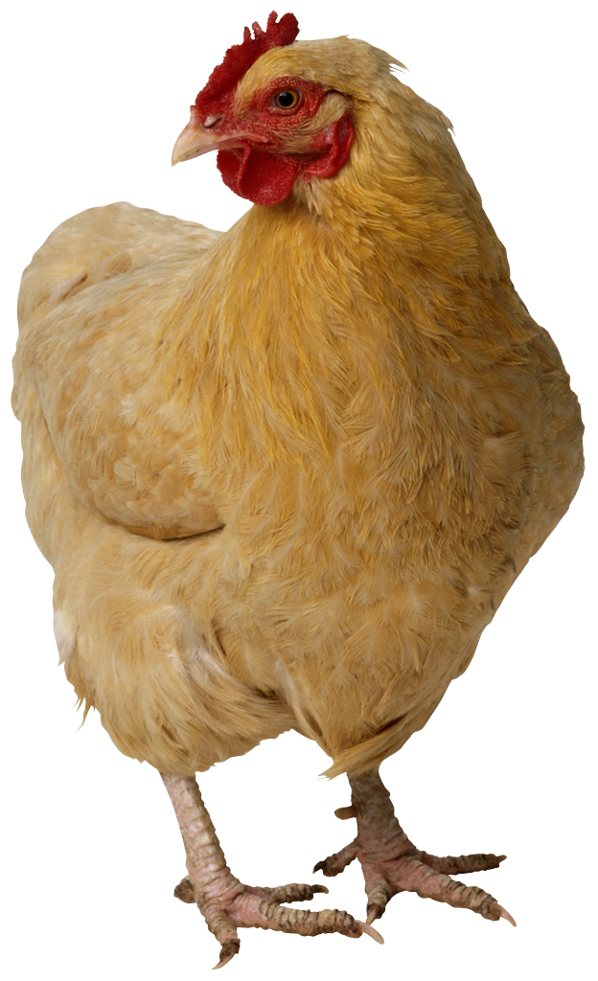
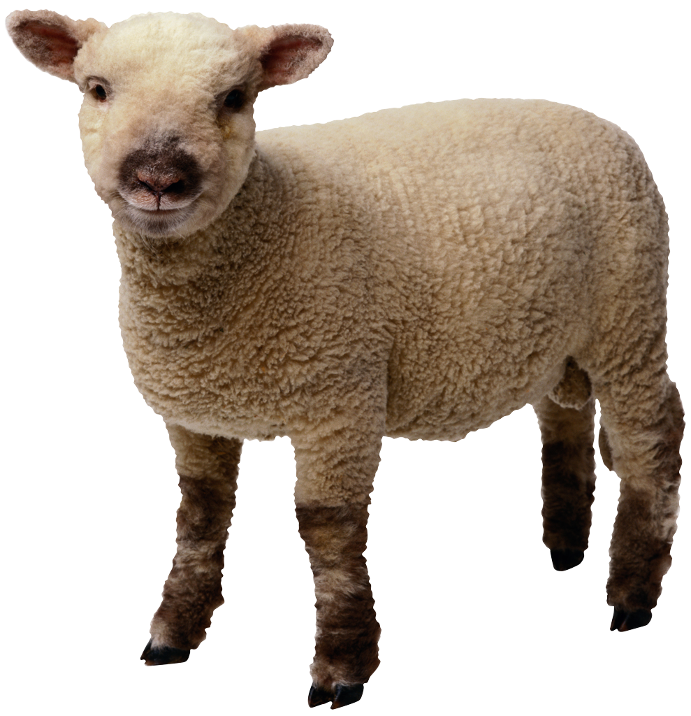
Generalization Example
You have a farm with many animal kinds.
Different food for each
You have directions that say
To feed dog, put dog food in dog dish
To feed chicken, put chicken food in chicken dish
To feed rabbit, put rabbit food in rabbit dish
Etc…
How could you do better?
To feed <animal>, put <animal> food in <animal> dish

Slide 13
Generalization (in BJC)
You are going to learn to write functions, like in math class:
y = sin(x)
You should think about what inputs make sense to use so you don’t have to duplicate code
“Function machine” from Simply Scheme (Harvey)

Slide 14
The Power of Abstraction, everywhere!
Examples:
Functions (e.g., sin x)
Hiring contractors
Application Programming Interfaces (APIs)
Technology (e.g., cars)
Amazing things are built when these layer
And the abstraction layers are getting deeper by the day!
We only need to worry about the interface, or specification, or contract
NOT how (or by whom) it’s built
Above the abstraction line
Abstraction Barrier (Interface) (the interface, or specification, or contract)
Below the abstraction line
This is where / how / when / by whom it is actually built, which is done according to the interface, specification, or contract.

Slide 15
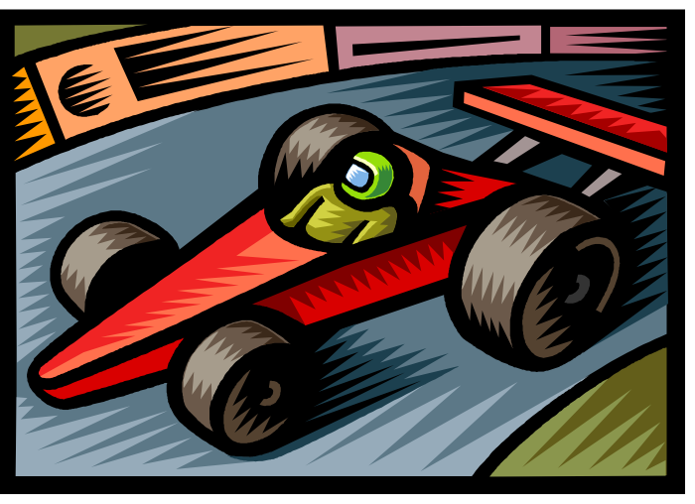
Summary
Abstraction is one of the big ideas of computing and computational thinking
Think about driving. How many of you know how a car works? How many can drive a car? Abstraction!
Someone who drove in 1930 could still drive a car today because they’ve kept the same Abstraction!
(right pedal faster, left pedal slow)

