Slide 1
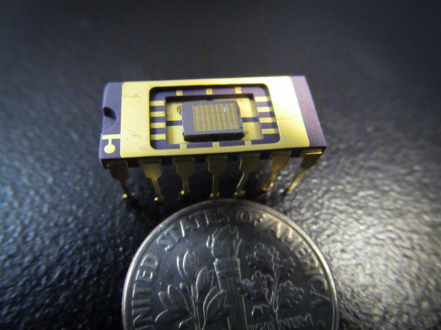
OPTICAL COMPUTING realized
inst.eecs.berkeley.edu/~cs61c UCB CS61C : Machine Structures Lecture 34 – Virtual Memory II 2010-04-16
Lecturer SOE Dan Garcia
Researchers at Stanford have developed “nanoscale single-mode LED”, which can transmit chip-to-chip data at 10 Gbs (10x what is currently used) at 1/1000th the energy. Pretty cool! (get it?) ☺
http://news.stanford.edu/news/2011/november/data-transmission-breakthrough-111511.html

Slide 2
Review
Next level in the memory hierarchy:
Provides program with illusion of a very large main memory:
Working set of “pages” reside in main memory - others reside on disk.
Also allows OS to share memory, protect programs from each other
Today, more important for protection vs. just another level of memory hierarchy
Each process thinks it has all the memory to itself
(Historically, it predates caches)

Slide 3
Review: View of the Memory Hierarchy
Regs
Upper Level
Instr. Operands
Faster
{
Cache
Blocks
Thus far
L2 Cache
Blocks
This week:
Virtual
Memory
{
Memory
Pages
Disk
Files
Larger
Tape
Lower Level

Slide 4
Mapping Virtual Memory to Physical Memory
Virtual Memory
Divide into equal sized chunks (about 4 KB - 8 KB)
Any chunk of Virtual Memory assigned to any chuck of Physical Memory (“page”)
∞
Stack
Physical Memory
64 MB
Heap
Static
Code
0
0

Slide 5
Another Model: Base and Bound Reg
∞
User C
$base+ $bound
Enough space for User D,
but discontinuous
(“fragmentation problem”)
User B
$base
Want:
discontinuous mapping
Process size >> mem
Addition not enough!
⇒ use Indirection!
User A
0
OS

Slide 6
Paging Organization (assume 32B pages)
Physical
Address
Page is unit of mapping
Virtual
Address
0000000
00000000
page 0
32B
page 0
32B
32B
Addr
Trans
MAP
00100000
page 1
32B
0100000
page 1
...
...
...
01000000
page 2
32B
page 3
...
...
...
1100000
32B
Physical
Memory
11100000
page 7
32B
Page also unit of transfer from disk to physical memory
Virtual Memory

Slide 7
Virtual Memory Mapping Function
Cannot have simple function to predict arbitrary mapping
Use table lookup of mappings
Use table lookup (“Page Table”) for mappings: Page number is index
Virtual Memory Mapping Function
Physical Offset = Virtual Offset
Physical Page Number = PageTable[Virtual Page Number]
(P.P.N. also called “Page Frame”)
Page Number Offset

Slide 8
Address Mapping: Page Table
Virtual Address:
page no.
offset
Page Table
Page Table
Base Reg
...
V
A.R.
P. P. A.
PPN
offset
index
into
page
table
Val
-id
Access
Rights
Physical
Page
Address
Physical
Memory
Address
.
...
Page Table located in physical memory

Slide 9
Page Table
A page table is an operating system structure which contains the mapping of virtual addresses to physical locations
There are several different ways, all up to the operating system, to keep this data around
Each process running in the operating system has its own page table
“State” of process is PC, all registers, plus page table
OS changes page tables by changing contents of Page Table Base Register

Slide 10
Requirements revisited
Remember the motivation for VM:
Sharing memory with protection
Different physical pages can be allocated to different processes (sharing)
A process can only touch pages in its own page table (protection)
Separate address spaces
Since programs work only with virtual addresses, different programs can have different data/code at the same address!
What about the memory hierarchy?

Slide 11
Page Table Entry (PTE) Format
Contains either Physical Page Number or indication not in Main Memory
OS maps to disk if Not Valid (V = 0)
If valid, also check if have permission to use page: Access Rights (A.R.) may be Read Only, Read/Write, Executable
...
V
A.R.
P. P.N.
Page Table
Val
-id
Access
Rights
Physical
Page
Number
P.T.E.
V
A.R.
P. P. N.
...

Slide 12
Paging/Virtual Memory Multiple Processes
User A: Virtual Memory
User B: Virtual Memory
∞
Physical
Memory
∞
Stack
Stack
64 MB
Heap
Heap
Static
Static
A
Page
Table
B
Page
Table
Code
0
Code
0
0

Slide 13
Comparing the 2 levels of hierarchy
Cache version Virtual Memory vers.
Block or Line Page
Miss Page Fault
Block Size: 32-64B Page Size: 4K-8KB
Placement: Fully Associative Direct Mapped, N-way Set Associative
Replacement: Least Recently Used LRU or Random (LRU)
Write Thru or Back Write Back

Slide 14
Notes on Page Table
Solves Fragmentation problem: all chunks same size, so all holes can be used
OS must reserve “Swap Space” on disk for each process
To grow a process, ask Operating System
If unused pages, OS uses them first
If not, OS swaps some old pages to disk
(Least Recently Used to pick pages to swap)
Each process has own Page Table
Will add details, but Page Table is essence of Virtual Memory

Slide 15
Why would a process need to “grow”?
~ FFFF FFFF_{hex}
A program’s address space contains 4 regions:
stack: local variables, grows downward
heap: space requested for pointers via malloc() ; resizes dynamically, grows upward
static data: variables declared outside main, does not grow or shrink
code: loaded when program starts, does not change
stack
heap
static data
code
~ 0_{hex}
For now, OS somehow prevents accesses between stack and heap (gray hash lines).

Slide 16
Virtual Memory Problem #1
Map every address  1 indirection via Page Table in memory per virtual address  1 virtual memory accesses = 2 physical memory accesses  SLOW!
Observation: since locality in pages of data, there must be locality in virtual address translations of those pages
Since small is fast, why not use a small cache of virtual to physical address translations to make translation fast?
For historical reasons, cache is called a Translation Lookaside Buffer, or TLB

Slide 17
Translation Look-Aside Buffers (TLBs)
TLBs usually small, typically 128 - 256 entries
Like any other cache, the TLB can be direct mapped, set associative, or fully associative
hit
VA
PA
TLB
Lookup
Cache
Main
Memory
Processor
miss
miss
hit
data
Trans-
lation
On TLB miss, get page table entry from main memory

Slide 18
Another Analogy
Book title like virtual address
Library of Congress call number like physical address
Card catalogue like page table, mapping from book title to call #
On card for book, in local library vs. in another branch like valid bit indicating in main memory vs. on disk
On card, available for 2-hour in library use (vs. 2-week checkout) like access rights

Slide 19
Peer Instruction
Locality is important yet different for cache and virtual memory (VM): temporal locality for caches but spatial locality for VM
VM helps both with security and cost
12
a) FF
b) FT
c) TF
d) TT
Notes:
Answer: [correct=5, TFF] Individual (6, 3, 6, 3, 34, 37, 7, 4)% & Team (9, 4, 4, 4, 39, 34, 0, 7)%
A: T [18/82 & 25/75] (The game breaks up very quickly into separate, independent games -- big win to solve separated & put together)
B: F [80/20 & 86/14] (The game tree grows exponentially! A better static evaluator can make all the difference!)
C: F [53/57 & 52/48] (If you're just looking for the best move, just keep theBestMove around [ala memoizing max])

Slide 20
Peer Instruction Answer
F A L S E
Locality is important yet different for cache and virtual memory (VM): temporal locality for caches but spatial locality for VM
VM helps both with security and cost
T R U E
1. No. Both for VM and cache
2. Yes. Protection and a bit smaller memory
12
a) FF
b) FT
c) TF
d) TT

Slide 21
And in conclusion…
Manage memory to disk? Treat as cache
Included protection as bonus, now critical
Use Page Table of mappings for each user vs. tag/data in cache
TLB is cache of Virtual  Physical addr trans
Virtual Memory allows protected sharing of memory between processes
Spatial Locality means Working Set of Pages is all that must be in memory for process to run fairly well

