Slide 1
61C In the News
October 11, 2011
GPUs Will Morph ORNL's Jaguar Into 20-Petaflop Titan
Michael Feldman
www.hpcwire.com/hpcwire/2011-10-11/gpus_will_morph_ornl_s_jaguar_into_20-petaflop_titan.html
The current Jaguar system … currently sits at number three on the TOP500 list...
Jaguar's days as a CPU-only supercomputer are numbered. Over the next year, the 2.3 petaflop machine at the Oak Ridge National Lab (ORNL) will be upgraded by Cray with the new NVIDIA "Kepler" GPUs, […] The transformed supercomputer will be renamed Titan and should deliver in the neighborhood of 20 peak petaflops sometime in late 2012.
"It's all about power efficiency"

Slide 2
CS 61C: Great Ideas in Computer Architecture (Machine Structures) Lecture 22 Thread Level Parallelism III
Instructors: Michael Franklin
Dan Garcia
http://inst.eecs.Berkeley.edu/~cs61c/Fa11

Slide 3
Review
Sequential software is slow software
SIMD and MIMD only path to higher performance
Multiprocessor (Multicore) uses Shared Memory (single address space)
Cache coherency implements shared memory even with multiple copies in multiple caches
False sharing a concern
MOESI Protocol ensures cache consistency and has optimizations for common cases.

Slide 4
Threads
thread of execution: smallest unit of processing scheduled by operating system
Threads have their own state or context:
Program counter, Register file, Stack pointer,
Threads share: a memory address space
Note: A “process” is a heavier-weight construct, which has its own address space. A process typically contains one or more threads.
Not to be confused with a processor, which is a physical device (i.e., a core)

Slide 5
Memory Model for Multi-threading
Process
CAN BE SPECIFIED IN A LANGUAGE WITH MIMD SUPPORT – SUCH AS OPENMP

Slide 6
Multithreading
On a single processor, multithreading occurs by time-division multiplexing:
Processor switched between different threads
may be “pre-emptive” or “non pre-emptive”
Context switching happens frequently enough that user perceives threads as running at the same time
On a multiprocessor, threads run at the same time, with each processor running a thread

Slide 7
Multithreading vs. Multicore
Basic idea: Processor resources are expensive and should not be left idle
For example: Long latency to memory on cache miss?
Hardware switches threads to bring in other useful work while waiting for cache miss
Cost of thread context switch must be much less than cache miss latency
Put in redundant hardware so don’t have to save context on every thread switch:
PC, Registers, …
Attractive for apps with abundant TLP

Slide 8
Data Races and Synchronization
Two memory accesses form a data race if from different threads, to same location, and at least one is a write, and they occur one after another
If there is a data race, result of program can vary depending on chance (which thread ran first?)
Avoid data races by synchronizing writing and reading to get deterministic behavior
Synchronization done by user-level routines that rely on hardware synchronization instructions

Slide 9
Lock and Unlock Synchronization
Lock used to create region (critical section) where only one thread can operate
Given shared memory, use memory location as synchronization point: lock or semaphore
Thread reads lock to see if it must wait, or OK to go into critical section (and set to locked)
0 => lock is free / open / unlocked / lock off
1 => lock is set / closed / locked / lock on
Set the lock
Critical section (only one thread gets to execute this section of code at a time)
e.g., change shared variables
Unset the lock

Slide 10
Possible Lock/Unlock Implementation
Lock (aka busy wait):
addiu $t1,$zero,1 ; t1 = 1 means Locked
Loop: lw $t0,lock($s0) ; load lock
bne $t0,$zero,Loop ; loop if locked
Lock: sw $t1,lock($s0) ; Unlocked, so lock
Unlock:
sw $zero,lock($s0)
Any problems with this?

Slide 11
Peer Instruction: What Happens?
addiu $t1,$zero, 1 ; t1 = 1 means locked
Loop: lw $t0, lock($s0) ; load lock
bne $t0, $zero, Loop ; loop if lock <> 0
Lock: sw $t1, lock($s0) ; set lock and continue ; to critical section
It works great! Ensures that at most one thread enters the critical section at a time.
Infinite Loop, since no change to lock before bne
Doesn’t work because a different thread on another core could see lock == 0 before sw changes it to 1; so both go to critical section
Doesn’t work because a different thread on this same core could see lock == 0 before sw changes it to 1; so both go to critical section
(A) I only (B) II only (C) III only (D) IV only (E) III and IV

Slide 12
Possible Lock Problem
Thread 1
addiu $t1,$zero,1
Loop: lw $t0,lock($s0)
bne $t0,$zero,Loop
Lock: sw $t1,lock($s0)
Thread 2
addiu $t1,$zero,1
Loop: lw $t0,lock($s0)
bne $t0,$zero,Loop
Lock: sw $t1,lock($s0)
Time
Both threads think they have set the lock
Exclusive access not guaranteed!

Slide 13
Help! Hardware Synchronization
Hardware support required to prevent interloper (either thread on other core or thread on same core) from changing the value
Atomic read/write memory operation
No other access to the location allowed between the read and write
Could be a single instruction
E.g., atomic swap of register ↔ memory
Or an atomic pair of instructions

Slide 14
Synchronization in MIPS
Load linked: ll rt,offset(rs)
Store conditional: sc rt,offset(rs)
Succeeds if location not changed since the ll
Returns 1 in rt (clobbers register value being stored)
Fails if location has changed
Returns 0 in rt (clobbers register value being stored)
Example: atomic swap (to test/set lock variable)
Exchange contents of reg and mem: $s4 ←→ ($s1)
try: add $t0,$zero,$s4 ;copy exchange value
ll $t1,0($s1) ;load linked
sc $t0,0($s1) ;store conditional
beq $t0,$zero,try ;branch store fails
add $s4,$zero,$t1 ;put load value in $s4

Slide 15
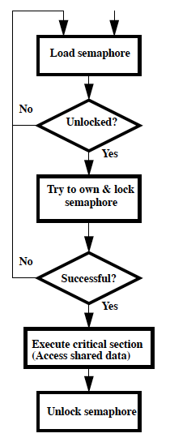
Test-and-Set
In a single atomic operation:
Test to see if a memory location is set (contains a 1)
Set it (to 1) If it isn’t (it contained a zero when tested)
Otherwise indicate that the Set failed, so the program can try again
No other instruction can modify the memory location, including another Test-and-Set instruction
Useful for implementing lock operations

Slide 16
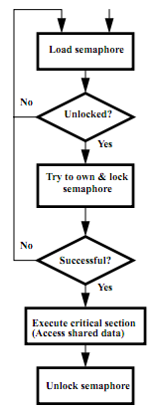
Test-and-Set in MIPS
Single atomic operation
Example: MIPS sequence for implementing a T&S at ($s1)
Try: addiu $t0,$zero,1
ll $t1,0($s1)
bne $t1,$zero,Try
sc $t0,0($s1)
beq $t0,$zero,try
Locked:
critical section
sw $zero,0($s1)

Slide 17
What is OpenMP?
API used for multi-threaded, shared memory parallelism
Compiler Directives
Runtime Library Routines
Environment Variables
Portable
Standardized
See http://www.openmp.org/, http://computing.llnl.gov/tutorials/openMP/

Slide 18
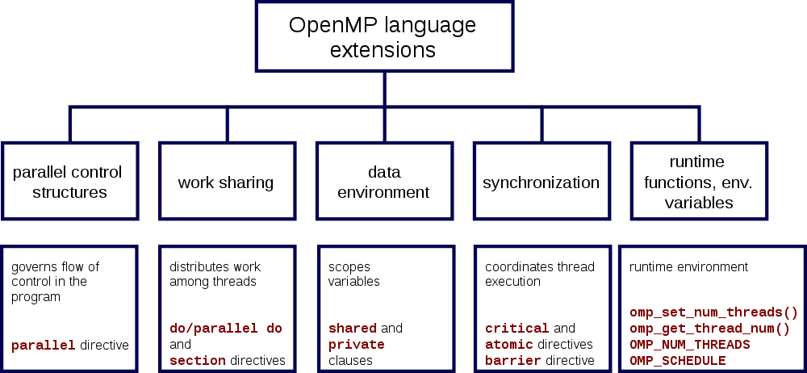
OpenMP Specification

Slide 19
Shared Memory Model with Explicit Thread-based Parallelism
Shared memory process consists of multiple threads, explicit programming model with full programmer control over parallelization
Pros:
Takes advantage of shared memory, programmer need not worry (that much) about data placement
Programming model is “serial-like” and thus conceptually simpler than alternatives (e.g., message passing/MPI)
Compiler directives are generally simple and easy to use
Legacy serial code does not need to be rewritten
Cons:
Codes can only be run in shared memory environments!
Compiler must support OpenMP (e.g., gcc 4.2)

Slide 20
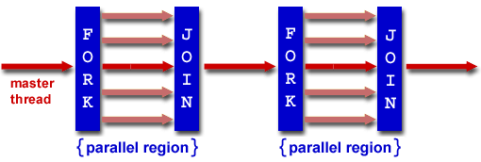
OpenMP Programming Model
Fork - Join Model:
OpenMP programs begin as single process: master thread; Executes sequentially until the first parallel region construct is encountered
FORK: the master thread then creates a team of parallel threads
Statements in program that are enclosed by the parallel region construct are executed in parallel among the various team threads
JOIN: When the team threads complete the statements in the parallel region construct, they synchronize and terminate, leaving only the master thread

Slide 21
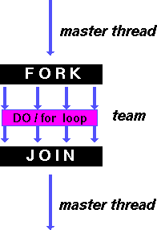
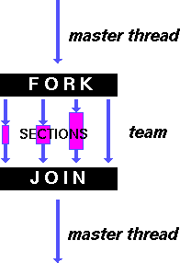
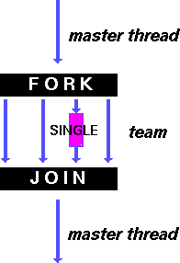
OpenMP Directives
shares iterations of a loop across the team
each section executed by a separate thread
serializes the execution of a thread

Slide 22
Building Block: C for loop
for (i=0; i<max; i++) zero[i] = 0;
Break for loop into chunks, and allocate each to a separate thread
E.g., if max = 100, with two threads, assign 0-49 to thread 0, 50-99 to thread 1
Must have relatively simple “shape” for an OpenMP-aware compiler to be able to parallelize it
Necessary for the run-time system to be able to determine how many of the loop iterations to assign to each thread
No premature exits from the loop allowed
i.e., No break, return, exit, goto statements

Slide 23
OpenMP Extends C with Pragmas
Pragmas are a mechanism C provides for language extensions
Commonly implemented pragmas: structure packing, symbol aliasing, floating point exception modes
Good mechanism for OpenMP because compilers that don't recognize a pragma are supposed to ignore them
Runs on sequential computer even with embedded pragmas

Slide 24
OpenMP: Parallel for pragma
#pragma omp parallel for
for (i=0; i<max; i++) zero[i] = 0;
Master thread creates additional threads, each with a separate execution context
All variables declared outside for loop are shared by default, except for loop index which is private per thread (Why?)
Implicit synchronization at end of for loop
Divide index regions sequentially per thread
Thread 0 gets 0, 1, …, (max/n)-1;
Thread 1 gets max/n, max/n+1, …, 2*(max/n)-1
Why?

Slide 25
Thread Creation
How many threads will OpenMP create?
Defined by OMP_NUM_THREADS environment variable (or in code procedure call)
Set this variable to the maximum number of threads you want OpenMP to use
Usually equals the number of cores in the underlying HW on which the program is run

Slide 26
OMP_NUM_THREADS
Shell command to set number threads:
export OMP_NUM_THREADS=x
Shell command check number threads:
echo $OMP_NUM_THREADS
OpenMP intrinsic to set number of threads:
omp_num_threads(x);
OpenMP intrinsic to get number of threads:
num_th = omp_get_num_threads();
OpenMP intrinsic to get Thread ID number:
th_ID = omp_get_thread_num();

Slide 27
Parallel Threads and Scope
Each thread executes a copy of the code within the structured block
#include <omp.h>
main () {
int nthreads, tid;
/* Fork a team of threads with each thread having a private tid variable */
#pragma omp parallel private(tid)
{
/* Obtain and print thread id */
tid = omp_get_thread_num();
printf("Hello World from thread = %d\n", tid);
/* Only master thread does this */
if (tid == 0)
{
nthreads = omp_get_num_threads();
printf("Number of threads = %d\n", nthreads);
}
} /* All threads join master thread and terminate */
}

Slide 28
Matrix Multiply in OpenMP
start_time = omp_get_wtime();
#pragma omp parallel for private(tmp, i, j, k)
for (i=0; i<Ndim; i++){
for (j=0; j<Mdim; j++){
tmp = 0.0;
for( k=0; k<Pdim; k++){
/* C(i,j) = sum(over k) A(i,k) * B(k,j) */
tmp += *(A+(i*Ndim+k)) * *(B+(k*Pdim+j));
}
*(C+(i*Ndim+j)) = tmp;
}
}
run_time = omp_get_wtime() - start_time;
Note: Outer loop spread across N threads; inner loops inside a thread

Slide 29
Notes on Matrix Multiply Example
More performance optimizations available
Higher compiler optimization (-O2, -O3) to reduce number of instructions executed
Cache blocking to improve memory performance
Using SIMD SSE3 Instructions to raise floating point computation rate

Slide 30
And in Conclusion, …
Sequential software is slow software
SIMD and MIMD only path to higher performance
Multiprocessor/Multicore uses Shared Memory
Cache coherency implements shared memory even with multiple copies in multiple caches
False sharing a concern; watch block size!
Data races lead to subtle parallel bugs
Synchronization via atomic operations:
MIPS does it with Load Linked + Store Conditional
OpenMP as simple parallel extension to C
Threads, Parallel for, private, critical sections, …

Slide 31
Bonus Slides

Slide 32
OpenMP Pitfall #1: Data Dependencies
Consider the following code:
a[0] = 1;
for(i=1; i<5; i++)
a[i] = i + a[i-1];
There are dependencies between loop iterations
Sections of loops split between threads will not necessarily execute in order
Out of order loop execution will result in undefined behavior

Slide 33
Open MP Pitfall #2: Avoiding Dependencies by Using Private Variables
Consider the following loop:
#pragma omp parallel for
{
for(i=0; i<n; i++){
temp = 2.0*a[i];
a[i] = temp;
b[i] = c[i]/temp;
}
}
Threads share common address space: will be modifying temp simultaneously; solution:
#pragma omp parallel for private(temp)
{
for(i=0; i<n; i++){
temp = 2.0*a[i];
a[i] = temp;
b[i] = c[i]/temp;
}
}

Slide 34
OpenMP Pitfall #3: Updating Shared Variables Simultaneously
Now consider a global sum:
for(i=0; i<n; i++)
sum = sum + a[i];
This can be done by surrounding the summation by a critical section, but for convenience, OpenMP also provides the reduction clause:
#pragma omp parallel for reduction(+:sum)
{
for(i=0; i<n; i++)
sum = sum + a[i];
}
Compiler can generate highly efficient code for reduction

Slide 35
OpenMP Pitfall #3: Parallel Overhead
Spawning and releasing threads results in significant overhead
Therefore, you want to make your parallel regions as large as possible
Parallelize over the largest loop that you can (even though it will involve more work to declare all of the private variables and eliminate dependencies)
Coarse granularity is your friend!

