Slide 1
In the News
Today, we’re pleased to introduce Crunch, a Java library that aims to make writing, testing, and running MapReduce pipelines easy, efficient, and even fun.
Crunch’s design is [… focused] on a small set of simple primitive operations and lightweight user-defined functions that can be combined to create complex, multi-stage pipelines.
At runtime, Crunch compiles the pipeline into a sequence of MapReduce jobs and manages their execution.
http://www.cloudera.com/blog/2011/10/introducing-crunch/

Slide 2
CS 61C: Great Ideas in Computer Architecture (Machine Structures) Lecture 19 – Data Parallelism II Flynn Taxonomy, SIMD
Instructors: Michael Franklin
Dan Garcia
http://inst.eecs.Berkeley.edu/~cs61c/Fa11

Slide 3
Review
Parallelism is one of the great ideas
Request Level Parallelism
For example, running lots of different web searches at the same time
Data Level Parallelism
At the disk/server level – scale out to solve bigger problems on more data
Map Reduce/Hadoop
At the memory level – today’s topic

Slide 4
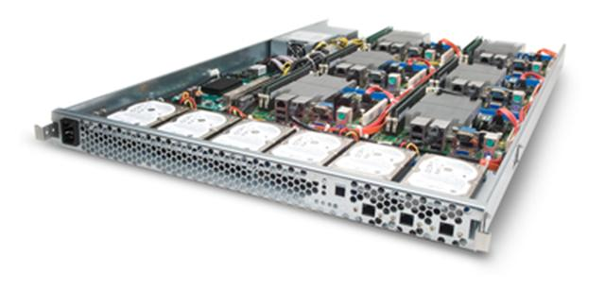
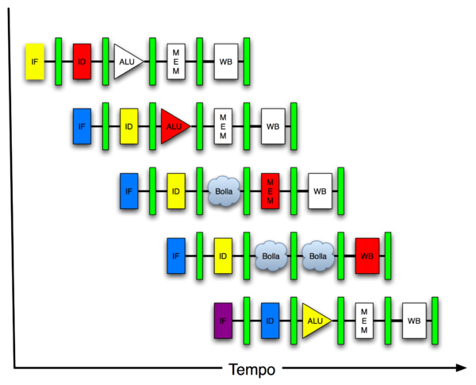
New-School Machine Structures (It’s a bit more complicated!)
Software Hardware
Parallel Requests
Assigned to computer
e.g., Search “Katz”
Parallel Threads
Assigned to core
e.g., Lookup, Ads
Parallel Instructions
>1 instruction @ one time
e.g., 5 pipelined instructions
Parallel Data
>1 data item @ one time
e.g., Add of 4 pairs of words
Hardware descriptions
All gates @ one time
Warehouse Scale Computer
Smart Phone
Harness Parallelism &
Achieve High Performance
Computer
Core
…
Core
Memory (Cache)
Input/Output
Core
Today’s
Lecture
Instruction Unit(s)
Functional
Unit(s)
A₀+B₀
A₁+B₁
A₂+B₂
A₃+B₃
Main Memory
Logic Gates

Slide 5
Agenda
Flynn Taxonomy
DLP and SIMD
Intel SSE (part 1)

Slide 6
Alternative Kinds of Parallelism: Hardware vs. Software
Concurrent software can also run on serial hardware
Sequential software can also run on parallel hardware
Our focus today is on sequential or concurrent software running on parallel hardware

Slide 7
Flynn Taxonomy
In 2011, SIMD and MIMD most common parallel computers
Most common parallel processing programming style: Single Program Multiple Data (“SPMD”)
Single program that runs on all processors of an MIMD
Cross-processor execution coordination through conditional expressions (thread parallelism - next lecture )
SIMD (aka hw-level data parallelism): specialized function units, for handling lock-step calculations involving arrays
Scientific computing, signal processing, multimedia (audio/video)

Slide 8
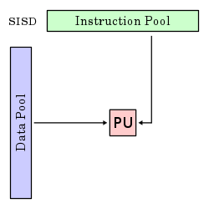
Flynn Taxonomy: SISD Single Instruction/Single Data Stream
Sequential computer that exploits no parallelism in either the instruction or data streams.
Examples of SISD architecture are traditional uniprocessor machines
Processing Unit

Slide 9
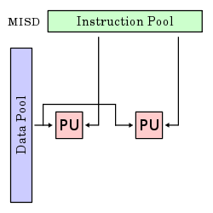
Flynn Taxonomy: MISD Multiple Instruction/Single Data Stream
Exploits multiple instruction streams against a single data stream for operations that can be naturally parallelized. E.g., certain kinds of array processors.
No longer commonly encountered, mainly of historical interest only

Slide 10
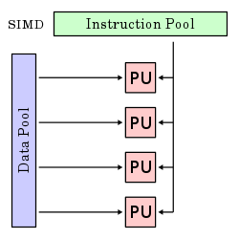
Flynn Taxonomy: SIMD Single Instruction/Multiple Data Stream
Computer that applies a single instruction stream to multiple data streams for operations that may be naturally parallelized
e.g., SIMD instruction extensions or Graphics Processing Unit (GPU)

Slide 11
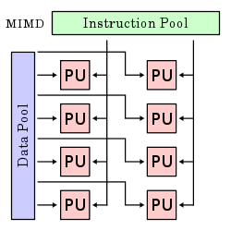
Flynn Taxonomy: MIMD Multiple Instruction/Multiple Data Streams
Multiple autonomous processors simultaneously executing different instructions on different data.
MIMD architectures include multicore and Warehouse Scale Computers
(Discuss in subsequent lectures)

Slide 12
SIMD Architectures
Data parallelism: executing one operation on multiple data streams
Example to provide context:
Multiplying a coefficient vector by a data vector (e.g., in filtering)
y[i] := c[i] × x[i], 0 ≤ i < n
Sources of performance improvement:
One instruction is fetched & decoded for entire operation
Multiplications are known to be independent
Pipelining/concurrency in memory access as well

Slide 13
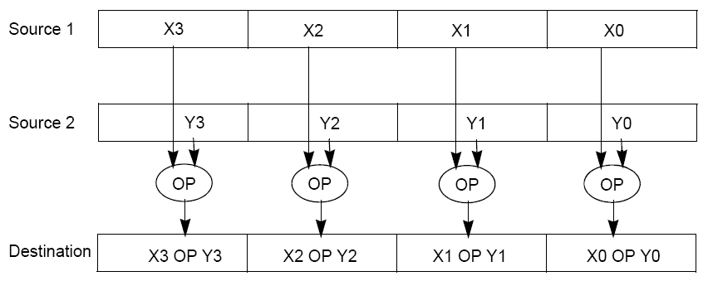
“Advanced Digital Media Boost”
To improve performance, Intel’s SIMD instructions
Fetch one instruction, do the work of multiple instructions
MMX (MultiMedia eXtension, Pentium II processor family)
SSE (Streaming SIMD Extension, Pentium III and beyond)

Slide 14
Example: SIMD Array Processing
for each f in array
f = sqrt(f)
for each f in array
{
load f to the floating-point register
calculate the square root
write the result from the register to memory
}
for each 4 members in array
{
load 4 members to the SSE register
calculate 4 square roots in one operation
write the result from the register to memory
}

Slide 15
Agenda
Flynn Taxonomy
DLP and SIMD
Intel SSE

Slide 16
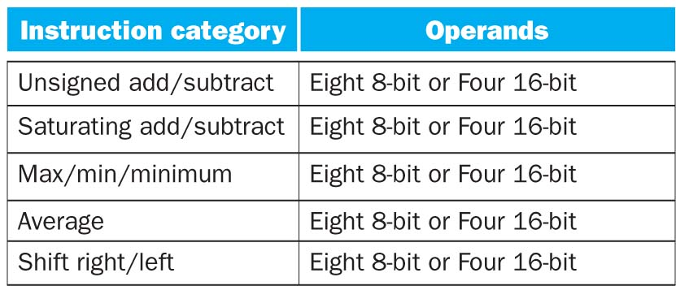
Instruction Categories for Multimedia Support
Above sizes are for MMX (SSE predecessor)
SSE supports wider data types to allow 16 x 8-bit and 8 x 16-bit operands

Slide 17
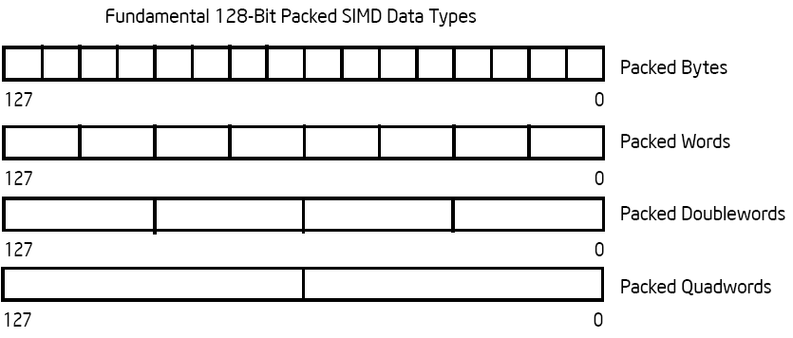
Intel Architecture SSE2+ 128-Bit SIMD Data Types
122 121
96 95
80 79
64 63
48 47
32 31
16 15
16 / 128 bits
122 121
96 95
80 79
64 63
48 47
32 31
16 15
8 / 128 bits
96 95
64 63
32 31
4 / 128 bits
64 63
2 / 128 bits
Note: in Intel Architecture (unlike MIPS) a word is 16 bits
Single precision FP: Double word (32 bits)
Double precision FP: Quad word (64 bits)

Slide 18
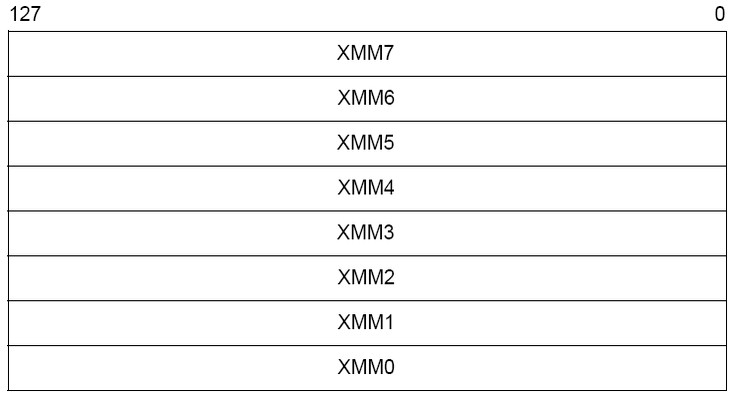
XMM Registers
Architecture extended with eight 128-bit data registers: XMM registers
IA 64-bit address architecture: available as 16 64-bit registers (XMM8 – XMM15)
E.g., 128-bit packed single-precision floating-point data type (doublewords), allows four single-precision operations to be performed simultaneously

Slide 19
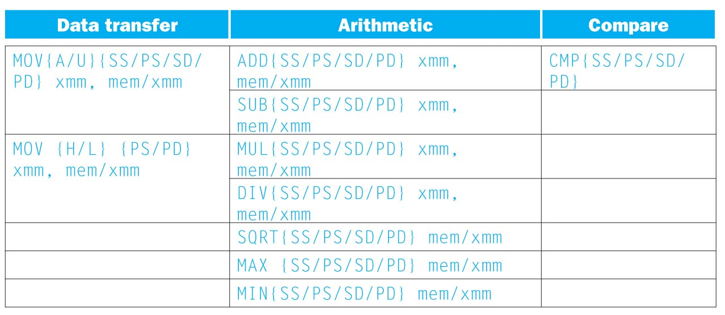
SSE/SSE2 Floating Point Instructions
xmm: one operand is a 128-bit SSE2 register
mem/xmm: other operand is in memory or an SSE2 register
{SS} Scalar Single precision FP: one 32-bit operand in a 128-bit register
{PS} Packed Single precision FP: four 32-bit operands in a 128-bit register
{SD} Scalar Double precision FP: one 64-bit operand in a 128-bit register
{PD} Packed Double precision FP, or two 64-bit operands in a 128-bit register
{A} 128-bit operand is aligned in memory
{U} means the 128-bit operand is unaligned in memory
{H} means move the high half of the 128-bit operand
{L} means move the low half of the 128-bit operand

Slide 20
Example: Add Two Single Precision FP Vectors
Computation to be performed:
vec_res.x = v1.x + v2.x;
vec_res.y = v1.y + v2.y;
vec_res.z = v1.z + v2.z;
vec_res.w = v1.w + v2.w;
SSE Instruction Sequence:
movaps address-of-v1, %xmm0
// v1.w | v1.z | v1.y | v1.x -> xmm0
addps address-of-v2, %xmm0
// v1.w+v2.w | v1.z+v2.z | v1.y+v2.y | v1.x+v2.x -> xmm0
movaps %xmm0, address-of-vec_res
mov a ps : move from mem to XMM register, memory aligned, packed single precision
add ps : add from mem to XMM register, packed single precision
mov a ps : move from XMM register to mem, memory aligned, packed single precision

Slide 21
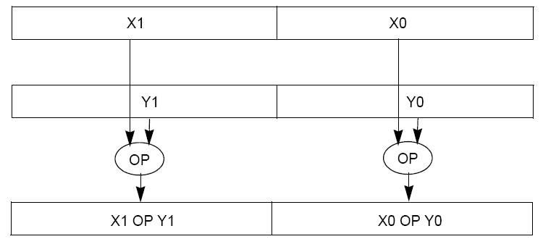
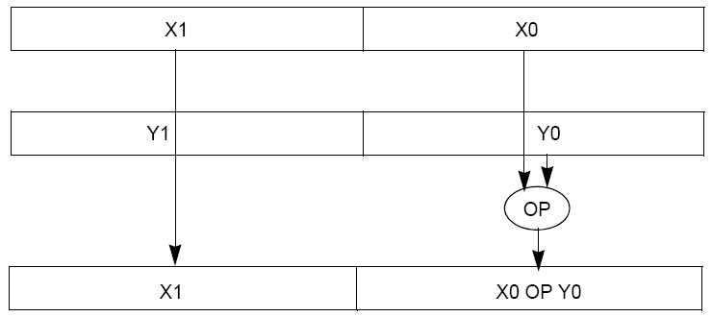
Packed and Scalar Double-Precision Floating-Point Operations

Slide 22
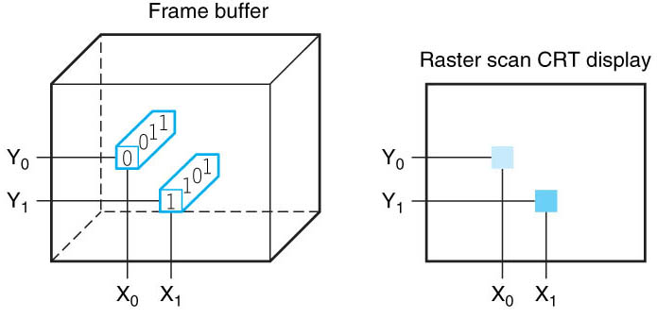
Displays and Pixels
Each coordinate in frame buffer on left determines shade of corresponding coordinate for the raster scan CRT display on right. Pixel (X0, Y0) contains bit pattern 0011, a lighter shade on the screen than the bit pattern 1101 in pixel (X1, Y1)

Slide 23
Example: Image Converter
Converts BMP (bitmap) image to a YUV (color space) image format:
Read individual pixels from the BMP image, convert pixels into YUV format
Can pack the pixels and operate on a set of pixels with a single instruction
E.g., bitmap image consists of 8 bit monochrome pixels
Pack these pixel values in a 128 bit register (8 bit * 16 pixels), can operate on 16 values at a time
Significant performance boost
Notes:
BMP File Format, also known as Bitmap Image File
The BMP File Format is capable of storing 2D digital images of arbitrary width, height, and resolution, both monochrome and color, in various color depths, and optionally with data compression, alpha channels, and color profiles.
YUV is a color space typically used as part of a color image pipeline.
The Y'UV model defines a color space in terms of one luma (Y') and two chrominance (UV) components.

Slide 24
Example: Image Converter
FMADDPS – Multiply and add packed single precision floating point instruction
One of the typical operations computed in transformations (e.g., DFT or FFT)
N
P = ∑ f(n) × x(n)
n = 1

Slide 25
Example: Image Converter
Floating point numbers f(n) and x(n) in src1 and src2; p in dest; C implementation for N = 4 (128 bits):
for (int i =0; i< 4; i++)
p = p + src1[i] * src2[i];
Regular x86 instructions for the inner loop:
//src1 is on the top of the stack; src1 * src2 -> src1
fmul DWORD PTR _src2$[%esp+148]
//p = ST(1), src1 = ST(0); ST(0)+ST(1) -> ST(1); ST-Stack Top
faddp %ST(0), %ST(1)
(Note: Destination on the right in x86 assembly)
Number regular x86 Fl. Pt. instructions executed: 4 * 2 = 8
Notes:
http://developer.amd.com/cpu/SSE5/Pages/default.aspx
"DE C0+i FADDP ST(i), ST(0) Add ST(0) to ST(i), store result in ST(i), and pop the register stack".
Destination on right called AT&T format

Slide 26
Example: Image Converter
Floating point numbers f(n) and x(n) in src1 and src2; p in dest; C implementation for N = 4 (128 bits):
for (int i =0; i< 4; i++)
p = p + src1[i] * src2[i];
SSE2 instructions for the inner loop:
//xmm0 = p, xmm1 = src1[i], xmm2 = src2[i]
mulps %xmm1, %xmm2 // xmm2 * xmm1 -> xmm2
addps %xmm2, %xmm0 // xmm0 + xmm2 -> xmm0
Number regular instructions executed: 2 SSE2 instructions vs. 8 x86
SSE5 instruction accomplishes same in one instruction:
fmaddps %xmm0, %xmm1, %xmm2, %xmm0
// xmm2 * xmm1 + xmm0 -> xmm0
// multiply xmm1 x xmm2 paired single, // then add product paired single to sum in xmm0
Number regular instructions executed: 1 SSE5 instruction vs. 8 x86
Notes:
http://developer.amd.com/cpu/SSE5/Pages/default.aspx
In AT&T syntax, the code on the slide should look like this (note Ichanged the comments, too).
One thing that is confusing is thatmulps/addps implicitly use one of the source operands as thedestination operand, but fmaddps has a fourth explicit destination. Iverified this is true.
//xmm0 = p, xmm1 = src1[i], xmm2 = src2[i]
mulps %xmm1, %xmm2 // xmm2 * xmm1 -> xmm2
addps %xmm2, %xmm0 // xmm0 * xmm2 -> xmm0
//SSE5 accomplishes this in one instruction:
fmaddps %xmm0, %xmm1, %xmm2, %xmm0 // xmm2 * xmm1 + xmm0 -> xmm0

Slide 27
So, in conclusion…
Flynn Taxonomy of Parallel Architectures
SIMD: Single Instruction Multiple Data
MIMD: Multiple Instruction Multiple Data
SISD: Single Instruction Single Data (unused)
MISD: Multiple Instruction Single Data
Intel SSE SIMD Instructions
One instruction fetch that operates on multiple operands simultaneously
128/64 bit XMM registers

